Slide 1

Coursera Capstone project
Comparsion of Prague and Bratislava trough Foursquere data
IBM Data Science Specialization
January 2021
Filip Förstl

Slide 2
Introduction and resreach question
Idea for this project is to compare two cities – Prague and Bratislava.
Both of them, are capitals of their countries, multicultural spots, administrative base and the most important financial hubs. I think, that would be interesting to compare their town districts with using of Foursquere data.
For Prague I have used Administative Districts for Bratislava I have used cadastral districts
Are there any big difference between Prague and Bratislava based on foursquare location data?
Which city is “richer” on venue’s categories according to foursquare data?
Can we see some similarities between Prague administrative districts and Bratislava cadastral districts?

Slide 3
Data
Target audience
Coordinates of cadastral districts for both cities, which I got from open sources database. Those databases offering both cities.
Data from Foursquere got by python scraping method together with using of developer API.
Administrative officials
Bussiness developers
Travelers, who planning to go to middle of Europe
Methodology
Trasform csv files of location data into dataframes
Using python scraping and Foursquere API to get venues
Use basic pandas functions to clean and fromat dataset
Perform k means clustering
Visualize results in map

Slide 4
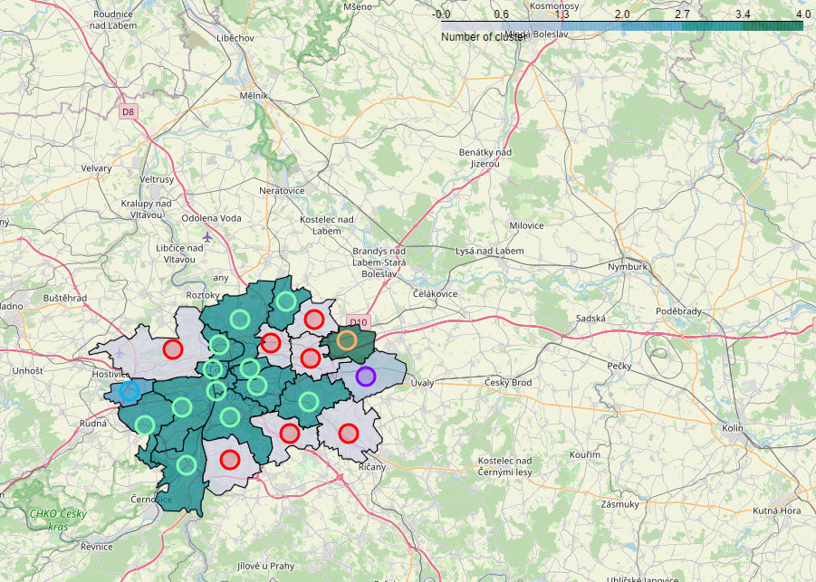
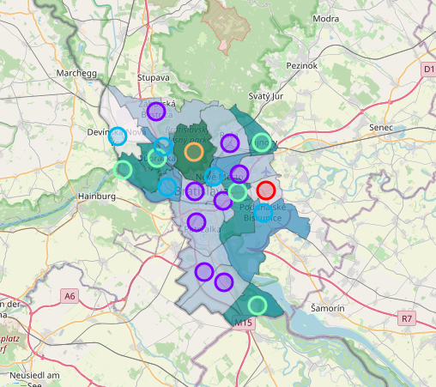
Results
Prague
Bratislava
For both cities were defined 5 clusters which segments districts based on similar composition of venues

Slide 5
Discussion
The observation leaded into answers of questions.
There are big differences in amounts of categories between cities – Prague has 285 unique categories, Bratislava has 77 unique categories.
Similarity in composition of restaurants potential represented by world countries.
In case of Bratislava is visible the border impact with Hungary and Czechia, so many restaurants are Hungarian or Czech.
Surprisingly a relatively big amount of yoga studios in case of Bratislava. (I really do not know why)
According those results I do not think that it offers any clear decision for visting one or other coutry.

Slide 6
Conclusion
According to this project I went throughout whole process of setting up a concept, identifying business problem, preparing the dataset, use machine learning method and answer the research questions.
That project gave me an opportunity to work with real dataset prepared by myself with using of machine learning method. I tried to lead whole project by my own and figured out all aspects which similar project needs to have

